Slide 1

Programming in Java
this, super, static & final Keywords
By
Ravi Kant Sahu
Asst. Professor, LPU

Slide 2
Contents
final keyword
this keyword
static keyword
super keyword
Ravi Kant Sahu, Asst. Professor @ Lovely Professional University, Punjab (India)

Slide 3
‘final’ Keyword
‘final’ keyword is used to:
  declare variables that can be assigned value only once (constant).
  final type identifier = expression;
  prevent overriding of a method.
  final return_type methodName (arguments if any)
  {
  body;
  }
  prevent inheritance from a class.
  final class Class_Name
  {
  class body;
  }
Ravi Kant Sahu, Asst. Professor @ Lovely Professional University, Punjab (India)

Slide 4

Java final variable
If you make any variable as final, you cannot change the value of final variable(It will be constant).
class Bike9{
final int speedlimit=90;//final variable
void run(){
speedlimit=400;
}
public static void main(String args[]){
Bike9 obj=new Bike9();
obj.run();
}
}
.

Slide 5
Java final method
If you make any method as final, you cannot override it.
class Bike{
final void run(){System.out.println("running");}
}
class Honda extends Bike{
void run(){System.out.println("running safely with 100kmph");}
public static void main(String args[]){
Honda honda= new Honda();
honda.run();
}
}

Slide 6
Java final class
If you make any class as final, you cannot extend it.
final class Bike{}
class Honda1 extends Bike{
void run(){System.out.println("running safely with 100kmph");}
public static void main(String args[]){
Honda1 honda= new Honda1();
honda.run();
}
}

Slide 7
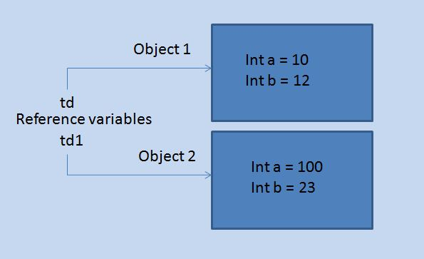
‘this’ Keyword
'this' is used for pointing the current class instance.
Within an instance method or a constructor, this is a reference to the current object — the object whose method or constructor is being called.
Ravi Kant Sahu, Asst. Professor @ Lovely Professional University, Punjab (India)

Slide 8
class ThisDemo1{
int a = 0;
int b = 0;
ThisDemo1(int x, int y)
{
this.a = x;
this.b = y;
}
public static void main(String [] args)
{
ThisDemo1 td = new ThisDemo1(10,12);
ThisDemo1 td1 = new ThisDemo1(100,23);
System.out.println(td.a);
System.out.println(td.B);
System.out.println(td1.a); System.out.println(td1.B); }
}
Ravi Kant Sahu, Asst. Professor @ Lovely Professional University, Punjab (India)
Notes:
10
12
100
23

Slide 9
Chaining of constructors using this keyword
Chaining of constructor means calling one constructor from other constructor.
We can invoke the constructor of same class using ‘this’ keyword.
We can invoke the super class constructor from subclass constructor using ‘super’ keyword.
Ravi Kant Sahu, Asst. Professor @ Lovely Professional University, Punjab (India)

Slide 10
class ThisDemo{
public ThisDemo() {
this(10); System.out.println("First Constructor");
}
public ThisDemo(int a) // overloaded constructor
{
this(10,20); System.out.println("Second Constructor");
}
public ThisDemo( int a, int B) // another overloaded constructor
{
this(“Ravi Kant"); System.out.println("Third Constructor");
}
public ThisDemo(String s) // and still another
{
System.out.println("Fourth Constructor");
}
public static void main(String args[]) {
ThisDemo first = new ThisDemo();
}
}
Ravi Kant Sahu, Asst. Professor @ Lovely Professional University, Punjab (India)

Slide 11
Constructor Chaining using ‘super’
class Parent{
public Parent() { System.out.println(“Parent Class");
}
}
class Parent2 extends Parent {
public Parent2(int x) { super();
System.out.println(“Parent2 Class: ”+ x );
}
}
class Child extends Parent2{
public Child() { System.out.println(“Child Class");
}
public static void main(String args[]) { Child c = new Child();
}
}
Ravi Kant Sahu, Asst. Professor @ Lovely Professional University, Punjab (India)

Slide 12
‘static’ Keyword
used to represent class members
Variables can be declared with the “static” keyword.
static int y = 0;
When a variable is declared with the keyword “static”, its called a “class variable”.
All instances share the same copy of the variable.
A class variable can be accessed directly with the class, without the need to create a instance.
Note: There's no such thing as static classs. “static” in front of class creates compilation error.
Ravi Kant Sahu, Asst. Professor @ Lovely Professional University, Punjab (India)

Slide 13
static methods
Methods can also be declared with the keyword “static”.
When a method is declared static, it can be used without creating an object.
class T2 {
static int triple (int n)
{return 3*n;}
}
class T1 {
public static void main(String[] arg)
{
System.out.println( T2.triple(4) );
T2 x1 = new T2();
System.out.println( x1.triple(5) );
}
}
Ravi Kant Sahu, Asst. Professor @ Lovely Professional University, Punjab (India)

Slide 14
Methods declared with “static” keyword are called “class methods”.
Otherwise they are “instance methods”.
Static Methods Cannot Access Non-Static Variables.
The following gives a compilation error, unless x is also static.
class T2 {
int x = 3;
static int returnIt () { return x;}
}
class T1 {
public static void main(String[] arg) { System.out.println( T2.returnIt() ); }
}
Ravi Kant Sahu, Asst. Professor @ Lovely Professional University, Punjab (India)

Slide 15
‘super’ Keyword
‘super’ keyword is used to:
  invoke the super-class constructor from the constructor of a sub-class.
  super (arguments if any);
  invoke the method of super-class on current object from sub-class.
  super.methodName (arguments if any);
  refer the super-class data member in case of name-conflict between super and sub-class data members.
  super.memberName;
Ravi Kant Sahu, Asst. Professor @ Lovely Professional University, Punjab (India)

Slide 16
Important
‘this’ and ‘super’ both are non-static.
So they can not be used inside static scope.
Ravi Kant Sahu, Asst. Professor @ Lovely Professional University, Punjab (India)

Slide 17


